Slide 1
Day 4
HTML & CSS

Slide 2
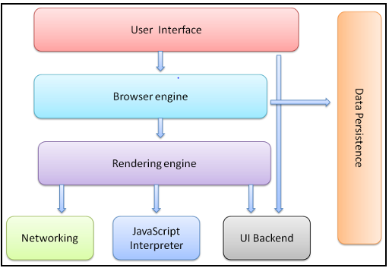
Browser Components
Notes:
Address bar for inserting a URI
Back and forward buttons
Bookmarking options
Refresh and stop buttons for refreshing or stopping the loading of current documents
Home button that takes you to your home page
The browser engine: marshals actions between the UI and the rendering engine.
Networking: for network calls such as HTTP requests, using different implementations for different platform behind a platform-independent interface.
This is a persistence layer. The browser may need to save all sorts of data locally, such as cookies. Browsers also support storage mechanisms such as localStorage, IndexedDB, WebSQL and FileSystem.

Slide 3

Rendering Engine
Parse HTML document & turn tags to DOM nodes in a tree
Parse style data and form the render tree
Render tree contains rectangles with visual attributes likes colors & dimensions.
Layout process: ;
Each node is given the exact coordinates where it should appear on the screen.
Painting:
Render tree is traversed and each node will be painted using the UI backend layer.

Slide 4
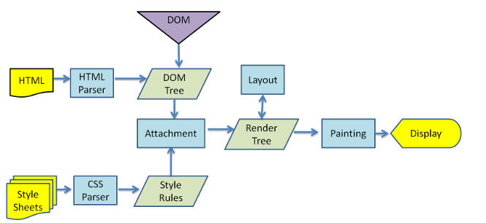
Rendering engine flow

Slide 5
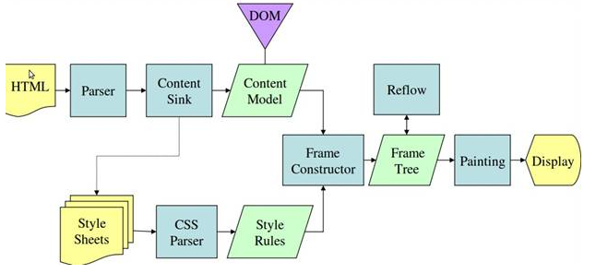
Gecko

Slide 6
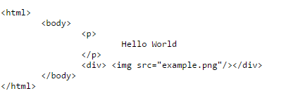
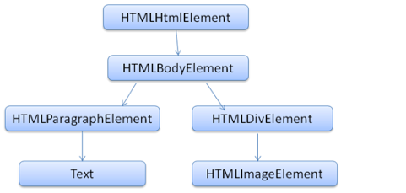
HTML Parser

Slide 7
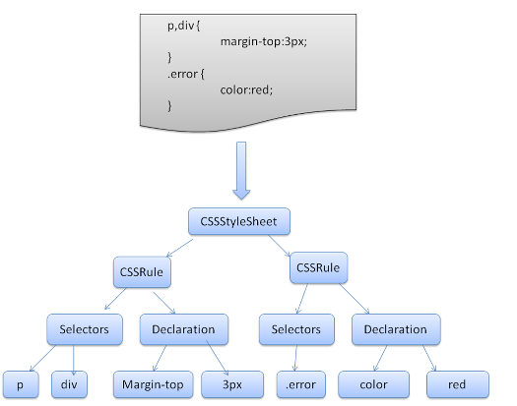
CSS Parser

